Slide 1
Finding the most similar Toronto neighborhood with South Korea
Applied Data Science Capstone course by IBM/Coursera
Eunkyung Gu
December 10, 2020

Slide 2
Predicting the similarity of Areas
Nowadays, there are quiet lots of Korean who try to immigrate to Canada for a variety of personal reasons, including career and academic issues.
Find the best place for Koreans to live in Toronto, Canada.
Specify the scope - people migrating from Seongdong-gu, Seoul to Downtown Toronto, Toronto.
I will try to find the locations that have similar facilities with Seoul.
This project could help Koreans who want to immigrate to Canada by representing the most adaptable neighborhood in Toronto.

Slide 3
Data acquisition and cleaning
The information of Neighborhood in Toronto, Canada including postal codes will be obtained from Wikipedia page. (https://en.wikipedia.org/wiki/List_of_postal_codes_of_Canada:_M)
The geographical coordinates of each postal code of Canada will be obtained from a csv file (http://cocl.us/Geospatial_data)
similarity of existing facilities in the neighborhood of Toronto and South Korea will be obtained using Foursquare API

Slide 4
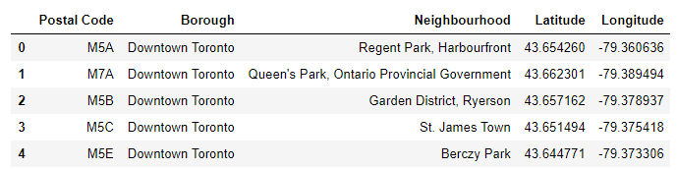
Data acquisition and cleaning
Dataframe of Downtown Toronto including Postal code, Geogrphical coordinates etc.

Slide 5
Data acquisition and cleaning
Geographical coordinate of Seongdong-gu, Seoul, South Korea
Latitude: 37.5635
Longitude: 127.0365

Slide 6
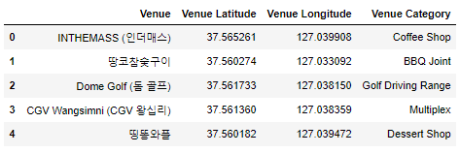
Data acquisition and cleaning
Venues in Seongdong-gu

Slide 7
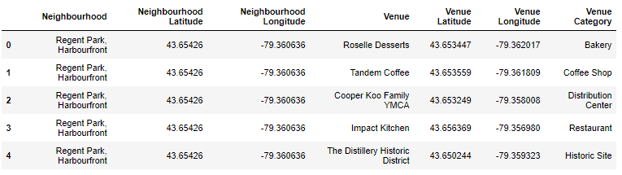
Data acquisition and cleaning
Venues in Toronto

Slide 8
How to analyze
Collect the required data: top 100 Venues and its category for both borough (Downtown Toronto, Seongdong-gu)
Cluster Neighborhoods of Downtown Toronto
K-Means Clustering
One-hot encoding method
3. Categorize the Seongdong-gu with cluster index of Downtown Toronto
Decision Tree model
One-hot encoding method

Slide 9
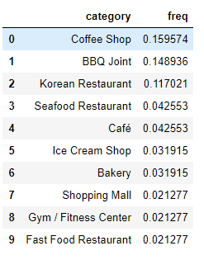
Explanatory Data analysis: Seongdong-gu

Slide 10
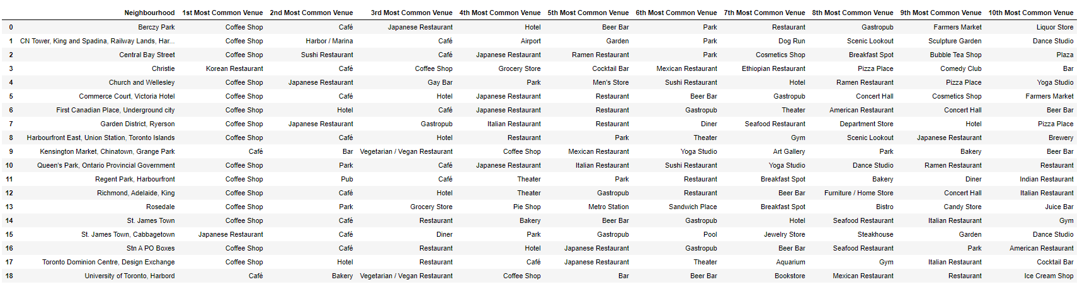
Explanatory Data analysis: Downtown Toronto

Slide 11
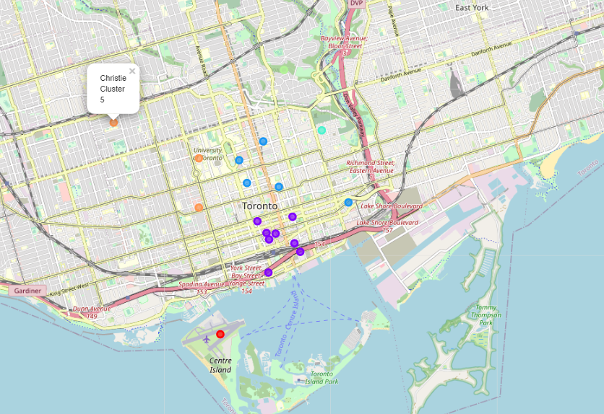
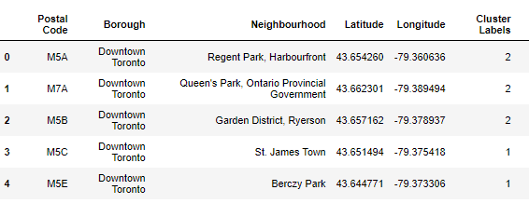
Clustering Neighborhoods in Downtown Toronto

Slide 12
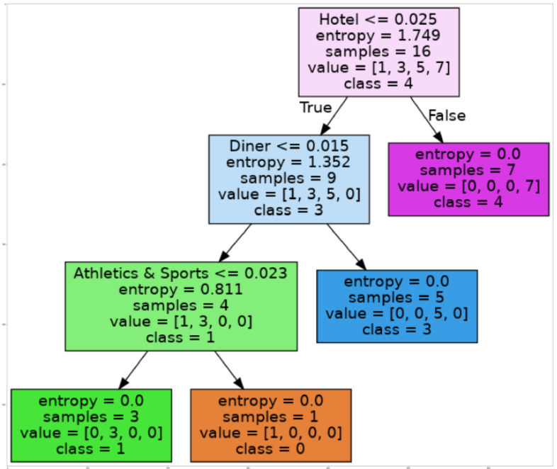
Classifying which cluster Seongdong-gu belongs to
By decision tree model trained with Downtown Toronto Dataset, Seongdong-gu belongs to cluster 2.

Slide 13
Which are neighborhoods in Downtown Toronto similar with Seongdong-gu?
Analysis showed that Seongdong-gu was predicted to belong to cluster 2. Cluster 2 is including the neighborhoods such as:
Christie
University of Toronto, Harbord
Kensington Market, Chinatown, Grange Park
From this point on, Koreans from Seongdong-gu will be able to adapt well when they move to these areas.

Slide 14
Limitation of this project
The accuracy of Decision tree showed quiet low at 0.67
The amount of dataset used was too small to train the model adequately.
There is room for further improving the model by increasing the amount of data
Clustering and classification index were created simply in proportion to the number of facilities. In other words, it is calculated without proper consideration of the overall ratio, which may give ambiguity to analysis.

Slide 15
Conclusion
This project showed neighborhoods ‘Christie/University of Toronto, Harbord/Kensington Market, Chinatown, Grange Park’ are most similar to Sengdong-gu.
The final decision on choosing the optimal location will be made by stakeholders based on the characteristics (included in this project or not) of the region. This project will be a good reference for them.

